Slide 1
ML report
2017.03.15
editor : GC 張之芃

Slide 2
What I’ve done
Learning the basic of machine learning
Practicing basic python syntax with modules
Doing practices with python
Start to do HW1 from ML online courses

Slide 3
About the tools
Numpy — a powerful mathematic compute module
Pandas — module using to reading data from files
Matplotlib — module using to graph
Tensorflow — machine learning module powered by Google

Slide 4
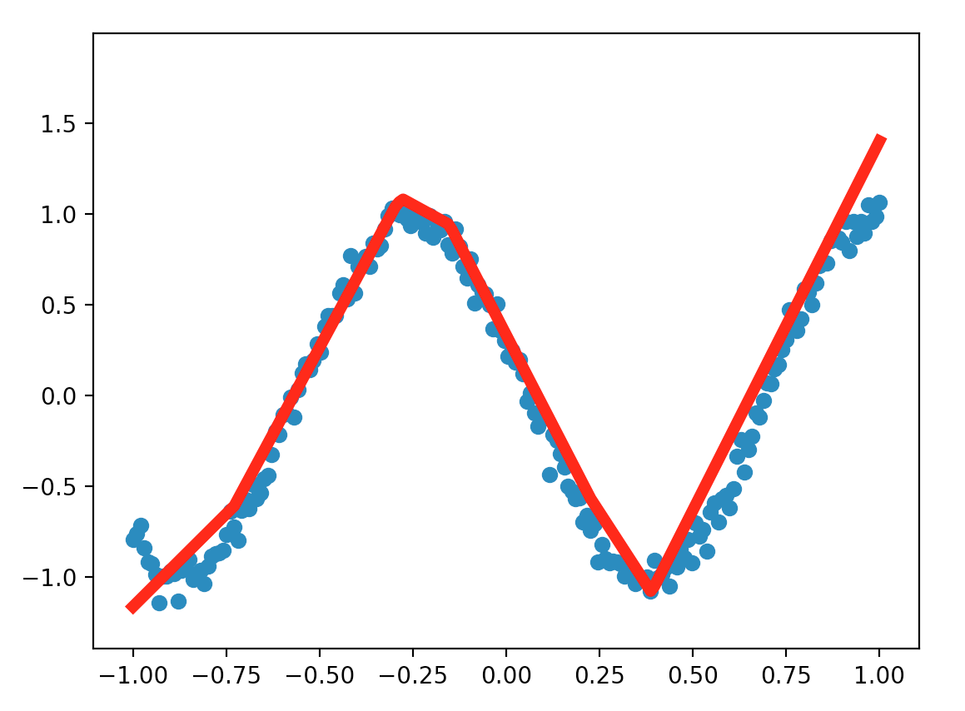
A practice using function cos() with noises to make machine learn the graph’s pattern

Slide 5
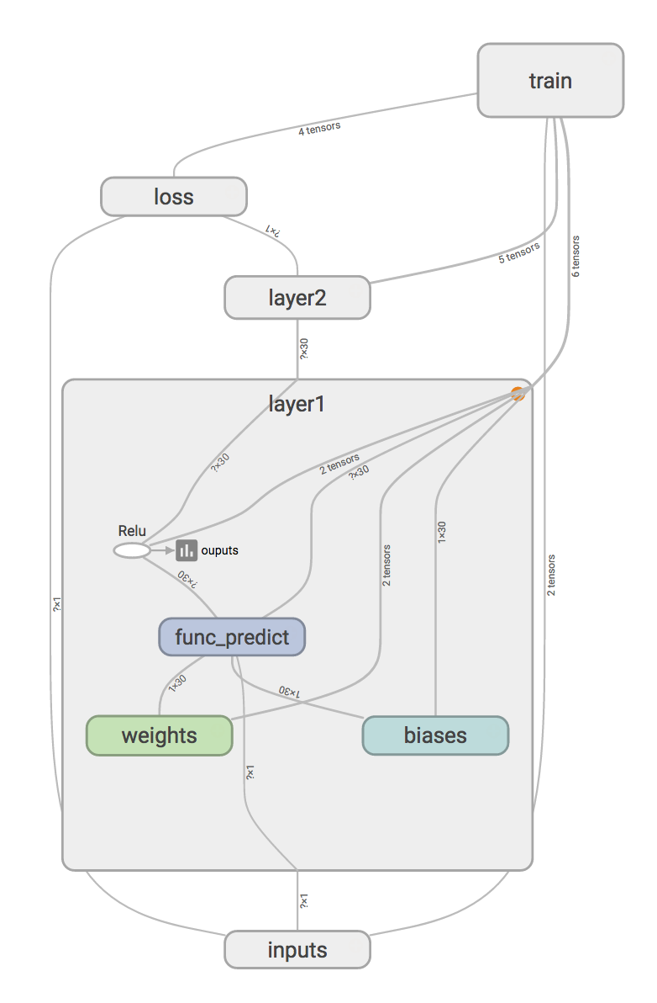
The structure of the neural network for function prediction
ReLU — activation function for approximating
loss — produce the error to train the network

Slide 6
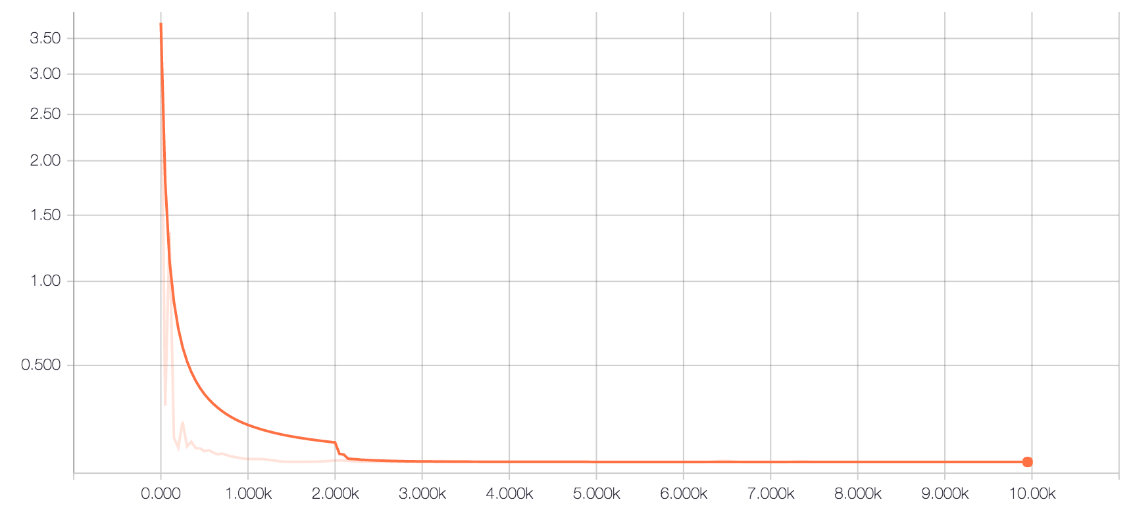
The loss of prediction
The training is 10k times in total and record loss every 50 times

Slide 7
What I’ve learnt
Knowing the basic element in ML
And a few technique making predict more precisely
Knowing which part need to keep studying

Slide 8
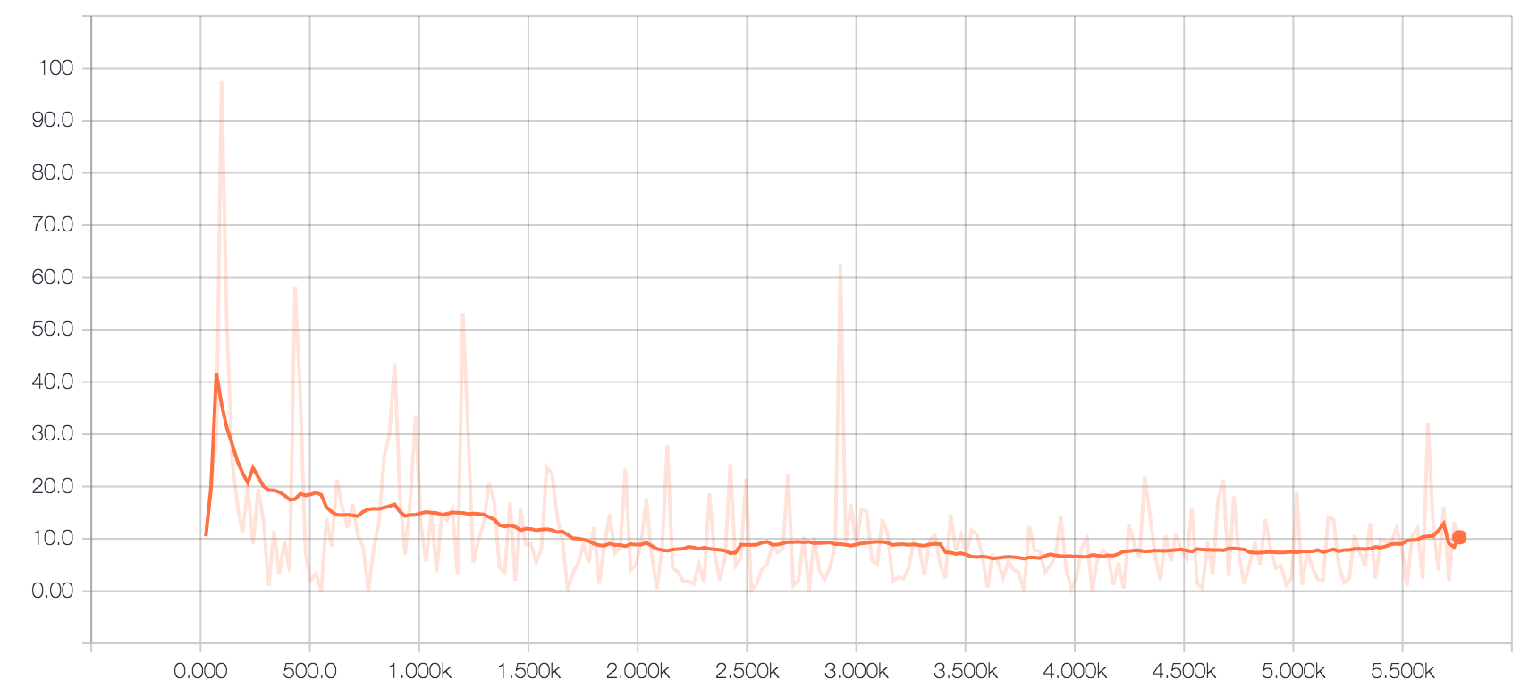
Still working on….
Train with 5760 datas and record every 24 times
The loss isn’t decrease stably in HW1
Still looking for possibly solution

